Slide 1



HO CHI MINH UNIVERSITY OF SCIENCE
FACULTY OF INFORMATION TECHNOLOGY
INTRODUCTION TO SOFTWARE ENGINEERING
FINAL REPORT
TEAM 04 - 16CLC1
January 10th, 2019
Lecturer: TS. Nguyễn Văn Vũ
TAs: ThS Nguyễn Đức Huy
ThS Ngô Chánh Đức

Slide 2
LIST OF TEAM MEMBERS
STT | Full Name | ID | Responsibility | Level of completion
1 | Nguyễn Anh Huy | 1653030 | Business Analyst, Designer, Developer | 100%
2 | Trần Minh Nhựt | 1653061 | Developer, Tester, User | 100%
3 | Trần Hải Phong | 1653063 | Business Analyst, Designer, Tester | 100%
4 | Trần Trọng Phúc | 1653067 | Project Manager, Developer, User | 100%
5 | Trình Đại Phúc | 1653068 | Developer, Tester, User | 100%

Slide 3
CONTENT
Content:
Overview
Scope
Organizational structure & responsibilities
Risk Management
Content:
Architecture goals & constraint
Logical view
Objective
Content:
Class diagram
UI Prototype
Content:
Test functions
Test environment
Roles
Test cases
Summary & Conclude
Content:
Order products
Checking order details
Schedule
Problem statement & product position statement
Use-case model
Non-requirements
SOFTWARE
REQUIREMENT
2. PROJECT MANAGEMENT
3. ANALYSIS AND DESIGN
4. SOFTWARE
TESTING
5. SOFTWARE DEMO

Slide 4
CONTENT
Content:
Overview
Scope
Organizational structure & responsibilities
Risk Management
Content:
Architecture goals & constraint
Non-requirements
Use-case model
Logical view
Class diagram
UI Prototype
Objective
Content:
Content:
Test functions
Test environment
Roles
Test cases
Summary & Conclude
Content:
Order products
Checking order details
Schedule
Problem statement & product position statement
SOFTWARE
REQUIREMENT
2. PROJECT MANAGEMENT
3. ANALYSIS AND DESIGN
4. SOFTWARE
TESTING
5. SOFTWARE DEMO

Slide 5

OVERVIEW
1. A web-based application.
Helping Vietnamese citizens to sell any food that they have
cooked or order any meal which they are interested in.
[1]

Slide 6
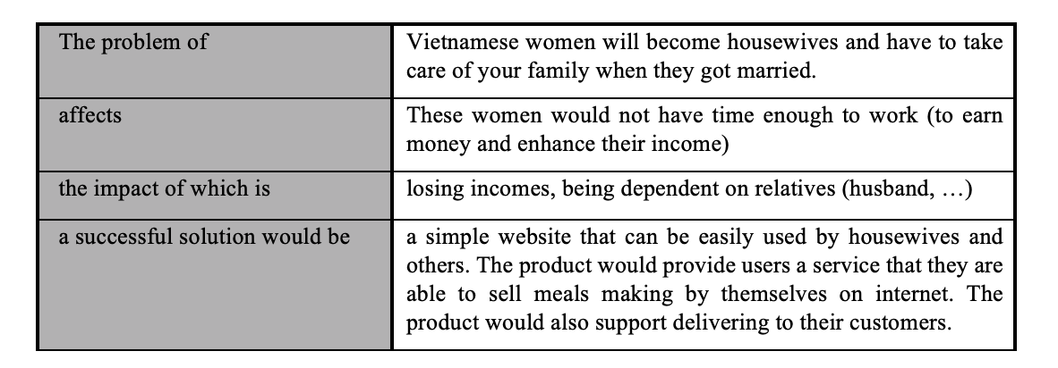
PROBLEM STATEMENT

Slide 7
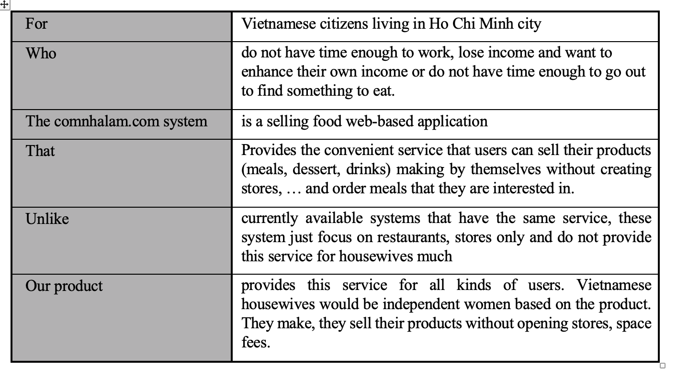
PRODUCT POSITION STATEMENT

Slide 8
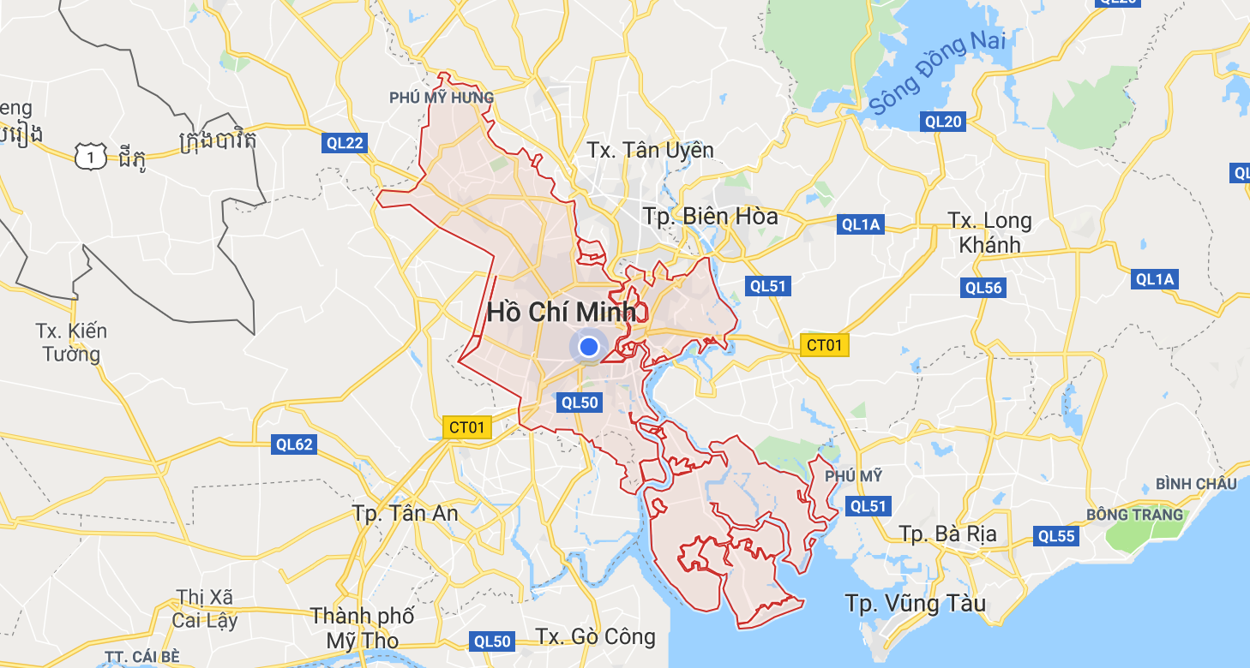
SCOPE
1. The project comnhalam.com is a selling food web-based application
only. Every users can use browsers to approach it.
The language of the website is Vietnamese only and the system serves citizens living in Ho Chi Minh city only.
1. SOFTWARE REQUIREMENT

Slide 9
OBJECTIVE
1. Comfortable and friendly layouts
2. Easily using must be the most important feature
3. Ordering process must be as simple as possible
1. SOFTWARE REQUIREMENT

Slide 10

EVERYDAY YOU HAVE TO COOK MEALS FOR YOUR FAMILY AND
DO NOT KNOW HOW TO INCREASE YOUR IMCOME ?
WE ARE YOUR BEST CHOICE !!!

Slide 11
CONTENT (Cons)
Content:
Overview
Scope
Organizational structure & responsibilities
Risk Management
Content:
Architecture goals & constraint
Logical view
Objective
Content:
Class diagram
UI Prototype
Content:
Test functions
Test environment
Roles
Test cases
Summary & Conclude
Content:
Order products
Checking order details
Schedule
Problem statement & product position statement
User-case model
SOFTWARE
REQUIREMENT
2. PROJECT MANAGEMENT
3. ANALYSIS AND DESIGN
4. SOFTWARE
TESTING
5. SOFTWARE DEMO

Slide 12
ORGANIZATIONAL STRUCTURE
Project Manager:
Trần Trọng Phúc
Developer
Business Analyst
Tester
Trần Trọng Phúc
Trình Đại Phúc
Trần Hải Phong
Trần Minh Nhựt
Designer
Trần Hải Phong
Nguyễn Anh Huy
User
Trình Đại Phúc
Trần Minh Nhựt
Trình Đại Phúc
Trần Minh Nhựt
Nguyễn Anh Huy
Trần Hải Phong
Nguyễn Anh Huy
Trần Trọng Phúc

Slide 13
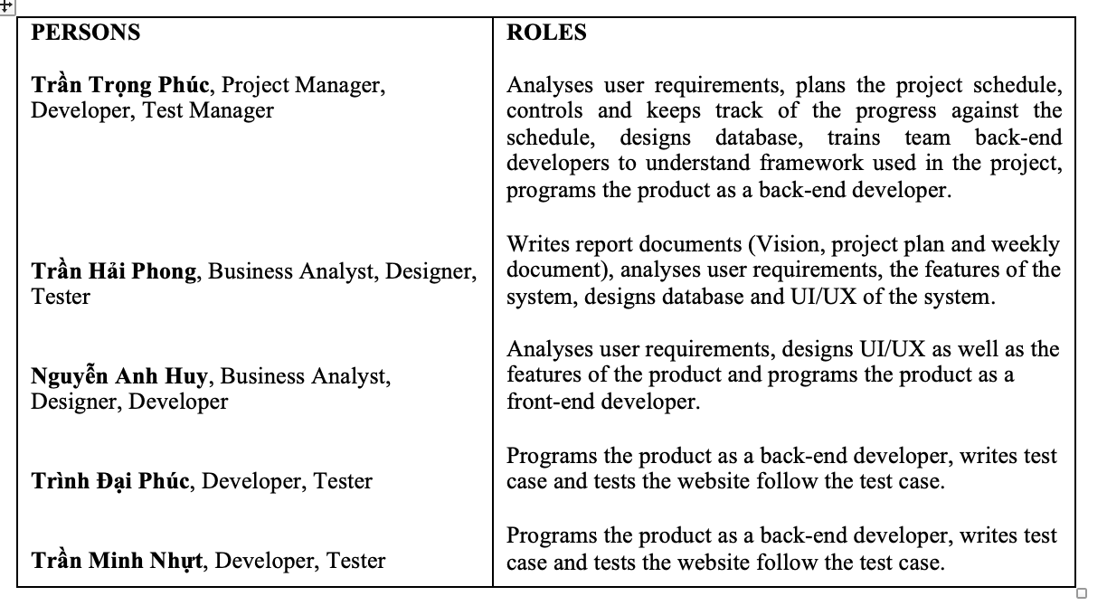
RESPONSIBILITIES
,Test Manager

Slide 14
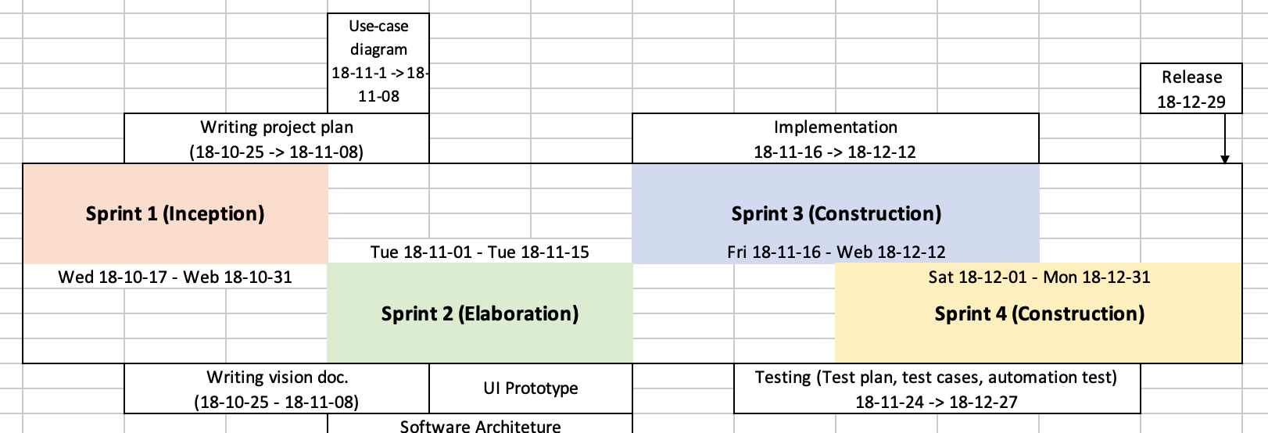
SCHEDULE

Slide 15
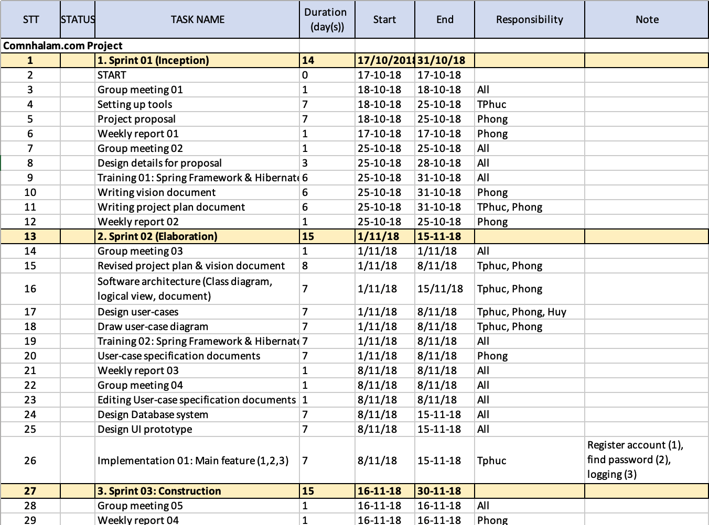
SCHEDULE

Slide 16
SCHEDULE

Slide 17
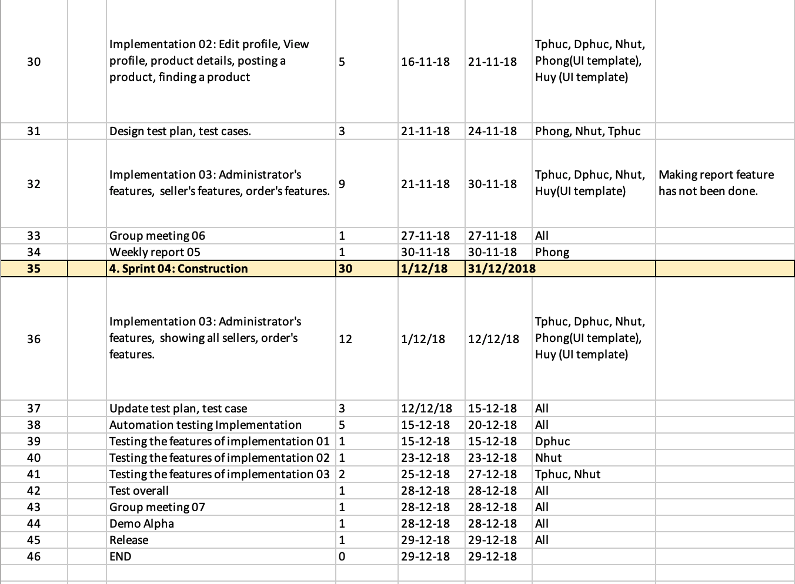
SCHEDULE

Slide 18
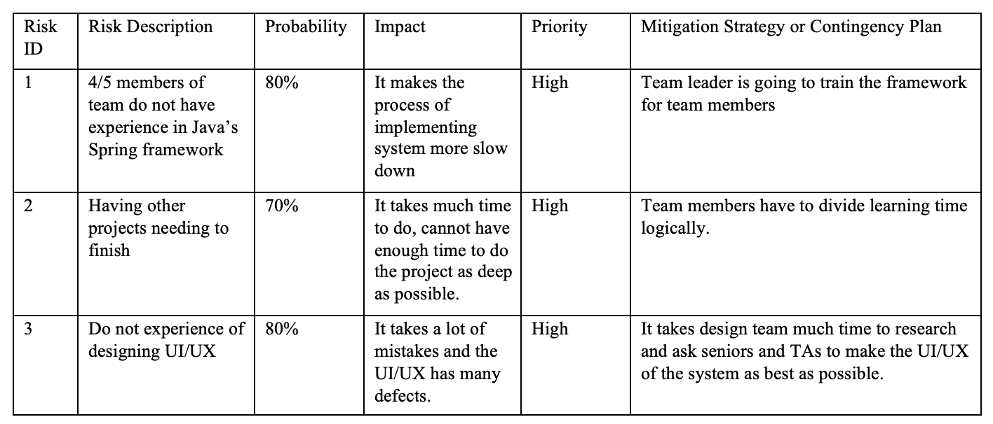
RISK MANAGEMENT

Slide 19
CONTENT (Cons)
Content:
Overview
Scope
Organizational structure & responsibilities
Risk Management
Content:
Architecture goals & constraint
Logical view
Objective
Content:
Class diagram
UI Prototype
Content:
Test functions
Test environment
Roles
Test cases
Summary & Conclude
Content:
Order products
Checking order details
Schedule
Problem statement & product position statement
User-case model
SOFTWARE
REQUIREMENT
2. PROJECT MANAGEMENT
3. ANALYSIS AND DESIGN
4. SOFTWARE
TESTING
5. SOFTWARE DEMO

Slide 20
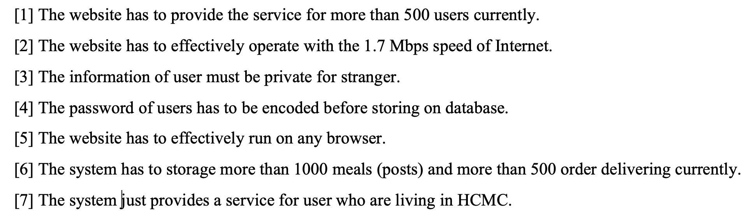
NON-FUNCTIONAL REQUIREMENTS

Slide 21
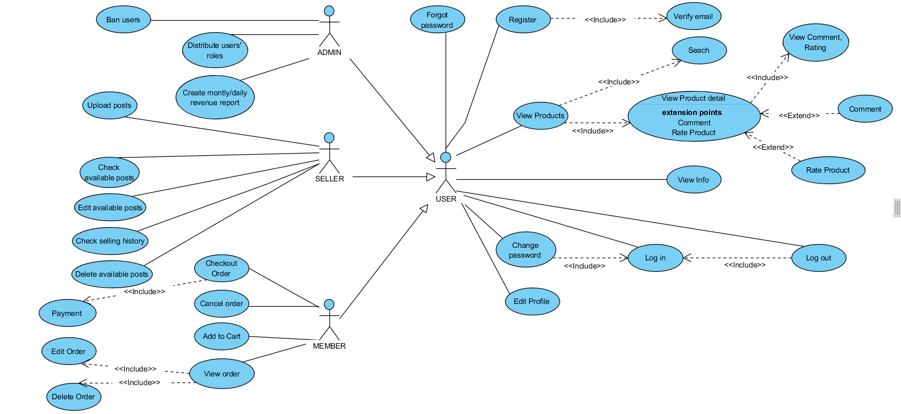
USE-CASE MODEL
1. SOFTWARE REQUIREMENT

Slide 22
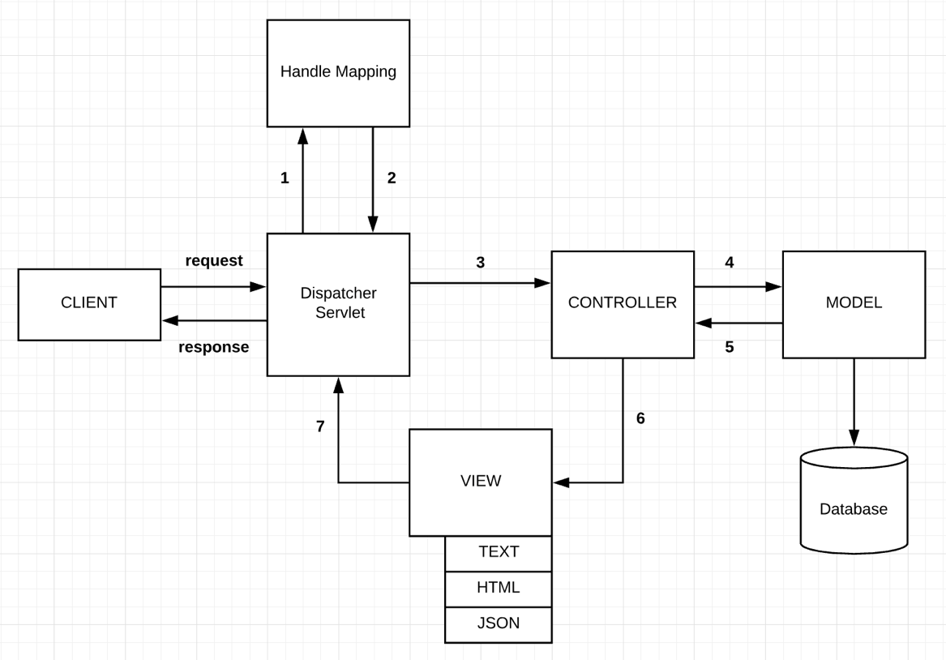
THE SYSTEM ARE IMPLEMENTED AS A MVC SYSTEM
Logical View

Slide 23
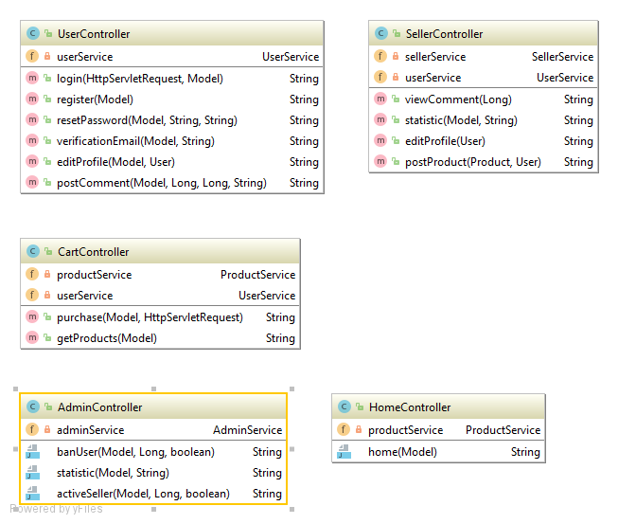
CLASS DIAGRAMS
1. Controller

Slide 24
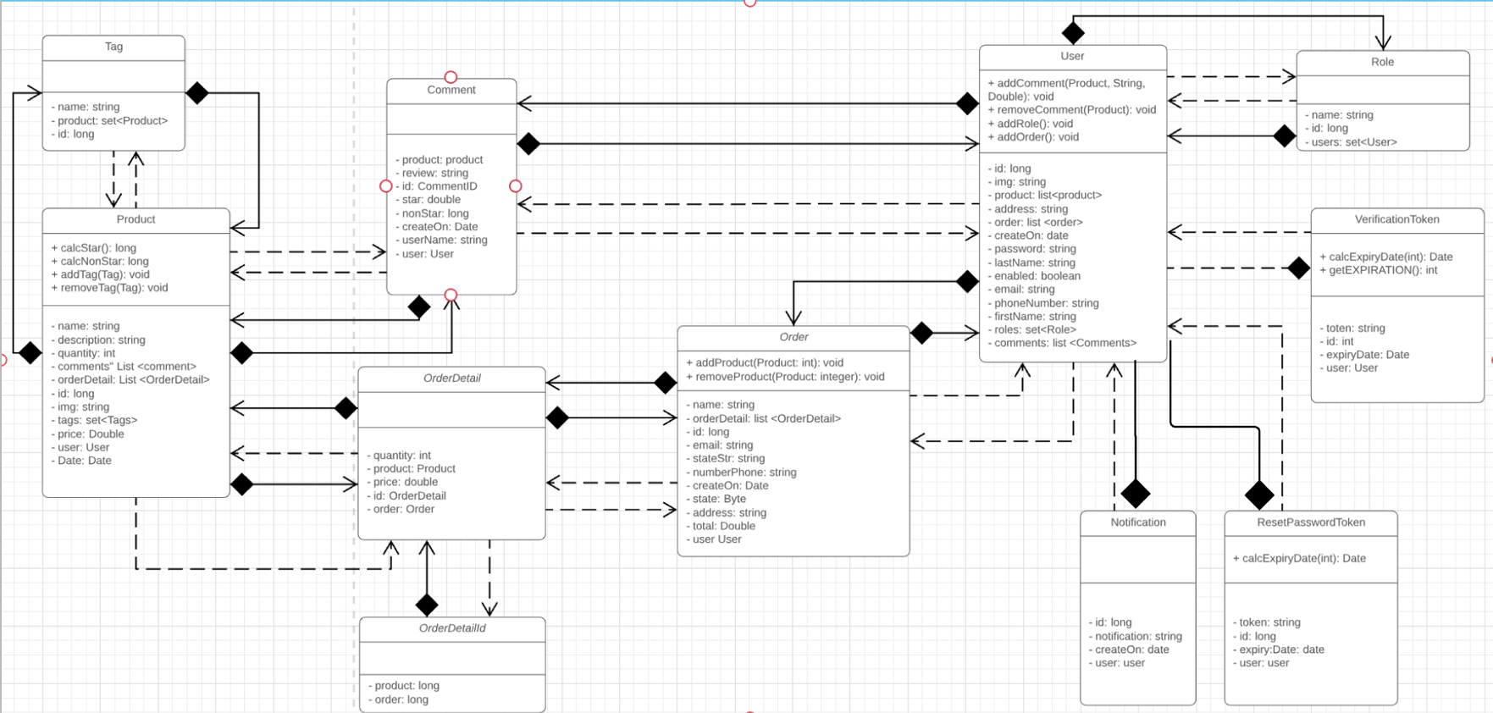
CLASS DIAGRAMS
2. Model

Slide 25
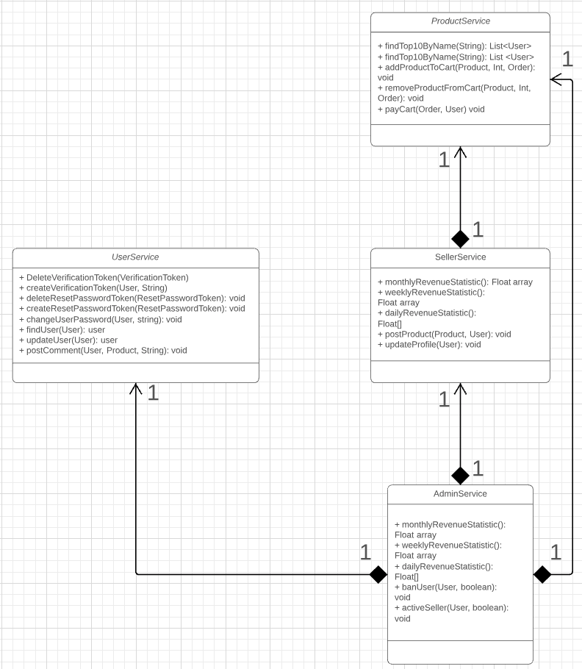
3. Service diagram

Slide 26
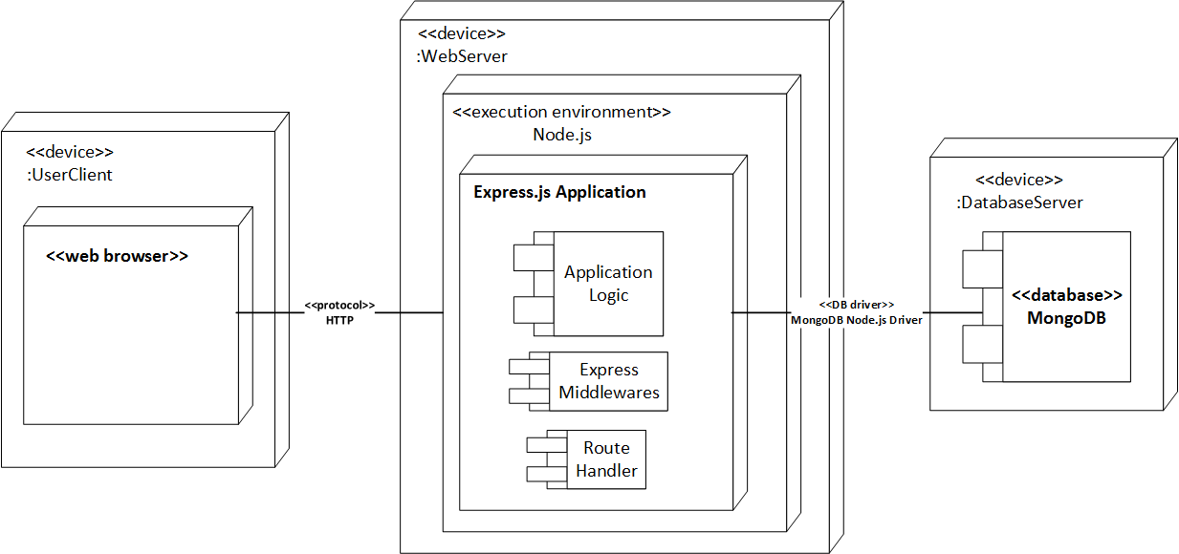

DEPLOYMENT VIEW
Spring Boot Application

Slide 27
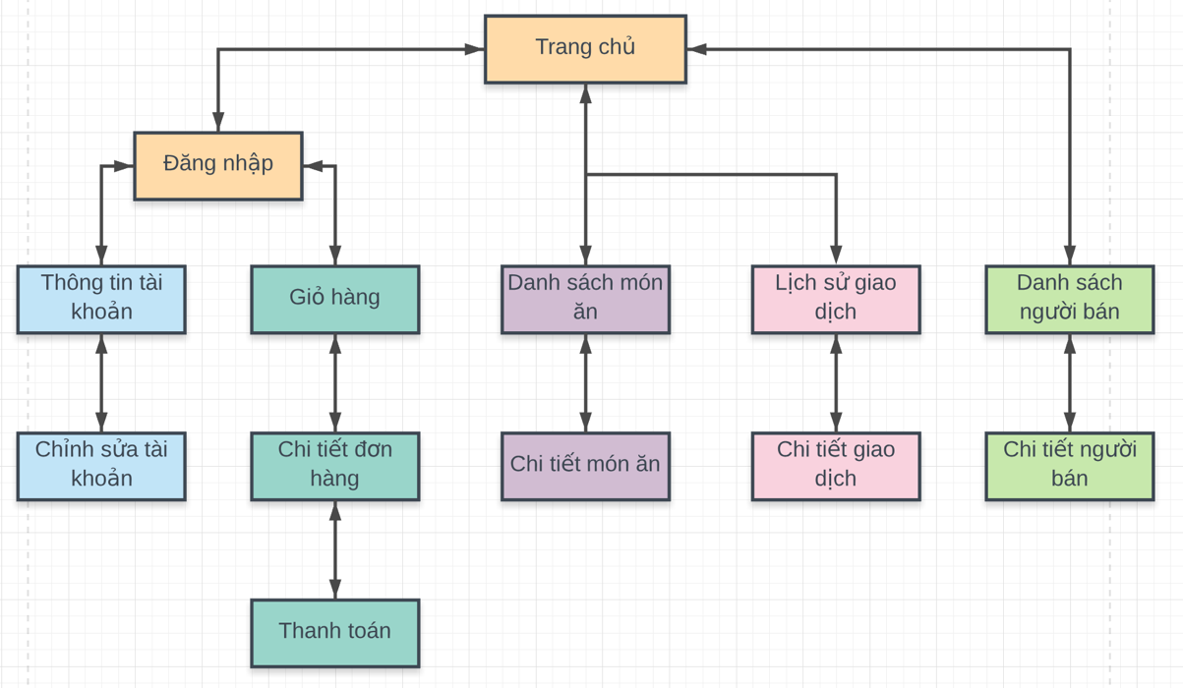
UI PROTOTYPE (1)
1
2
3
4
6
User

Slide 28
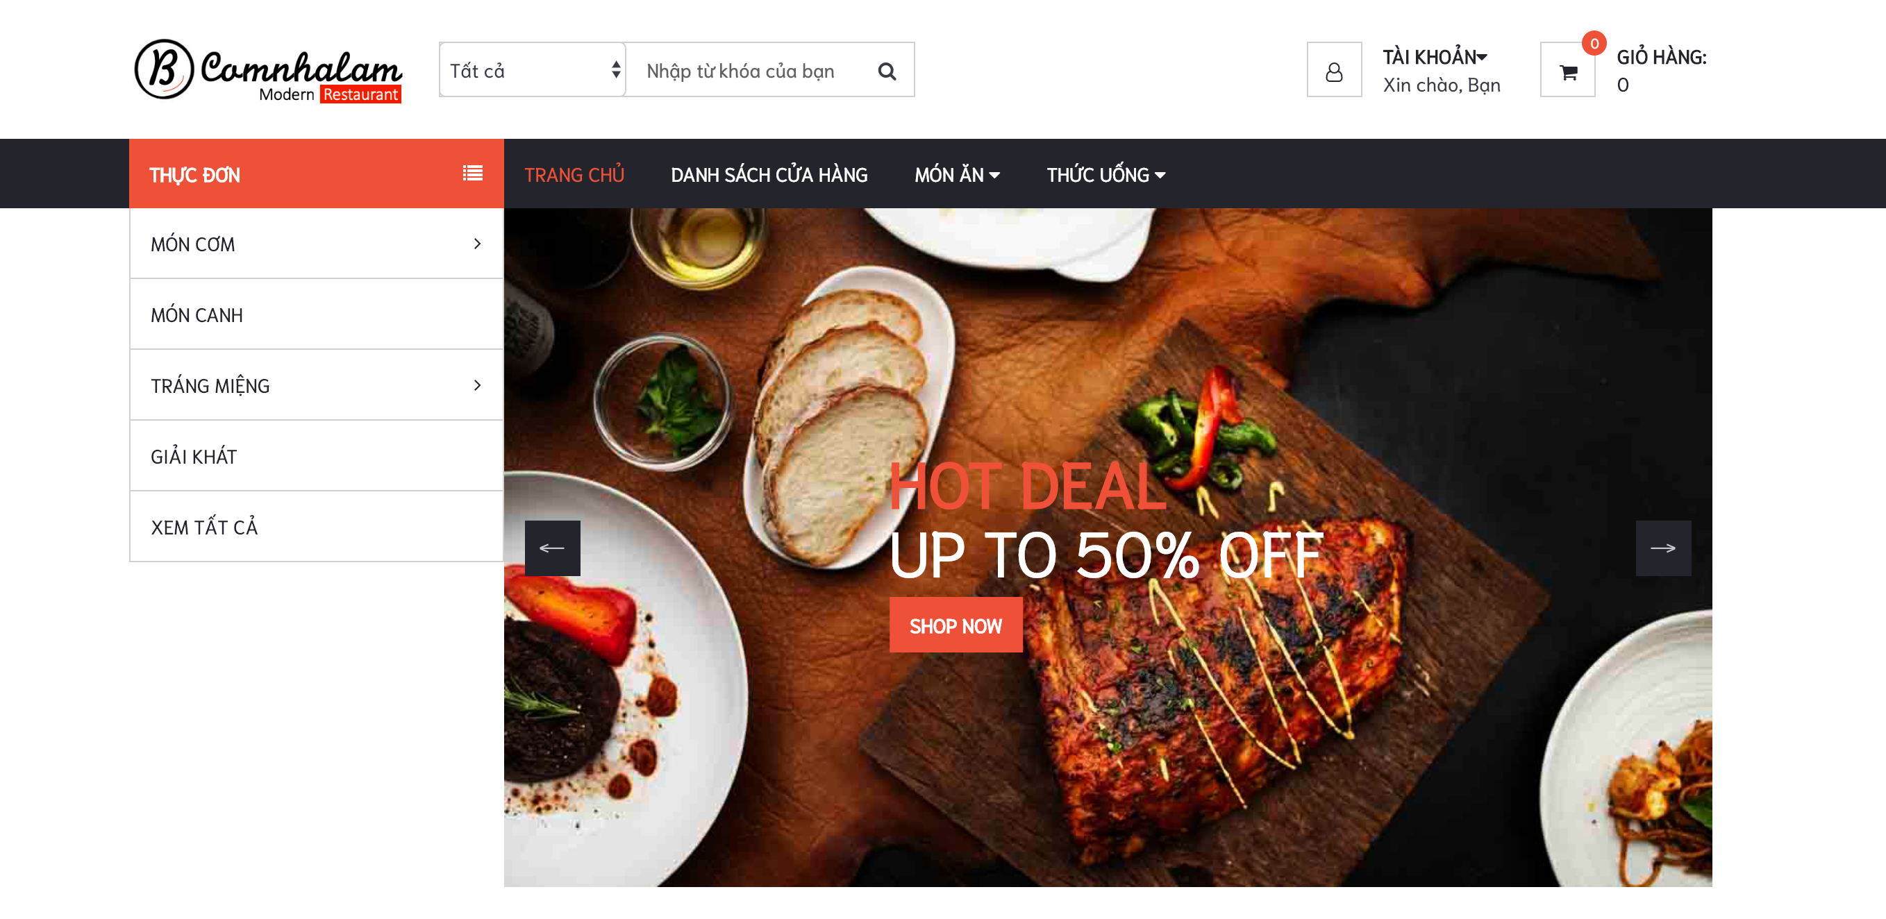
1

Slide 29
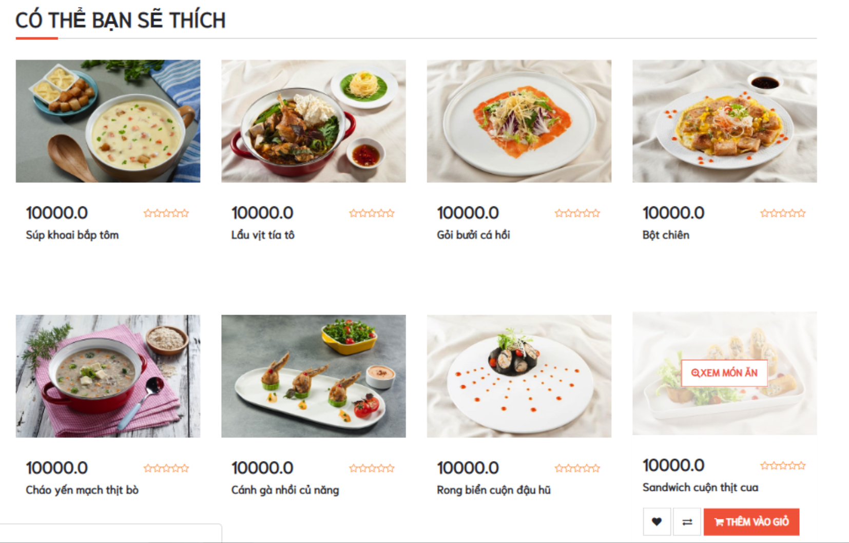
1

Slide 30
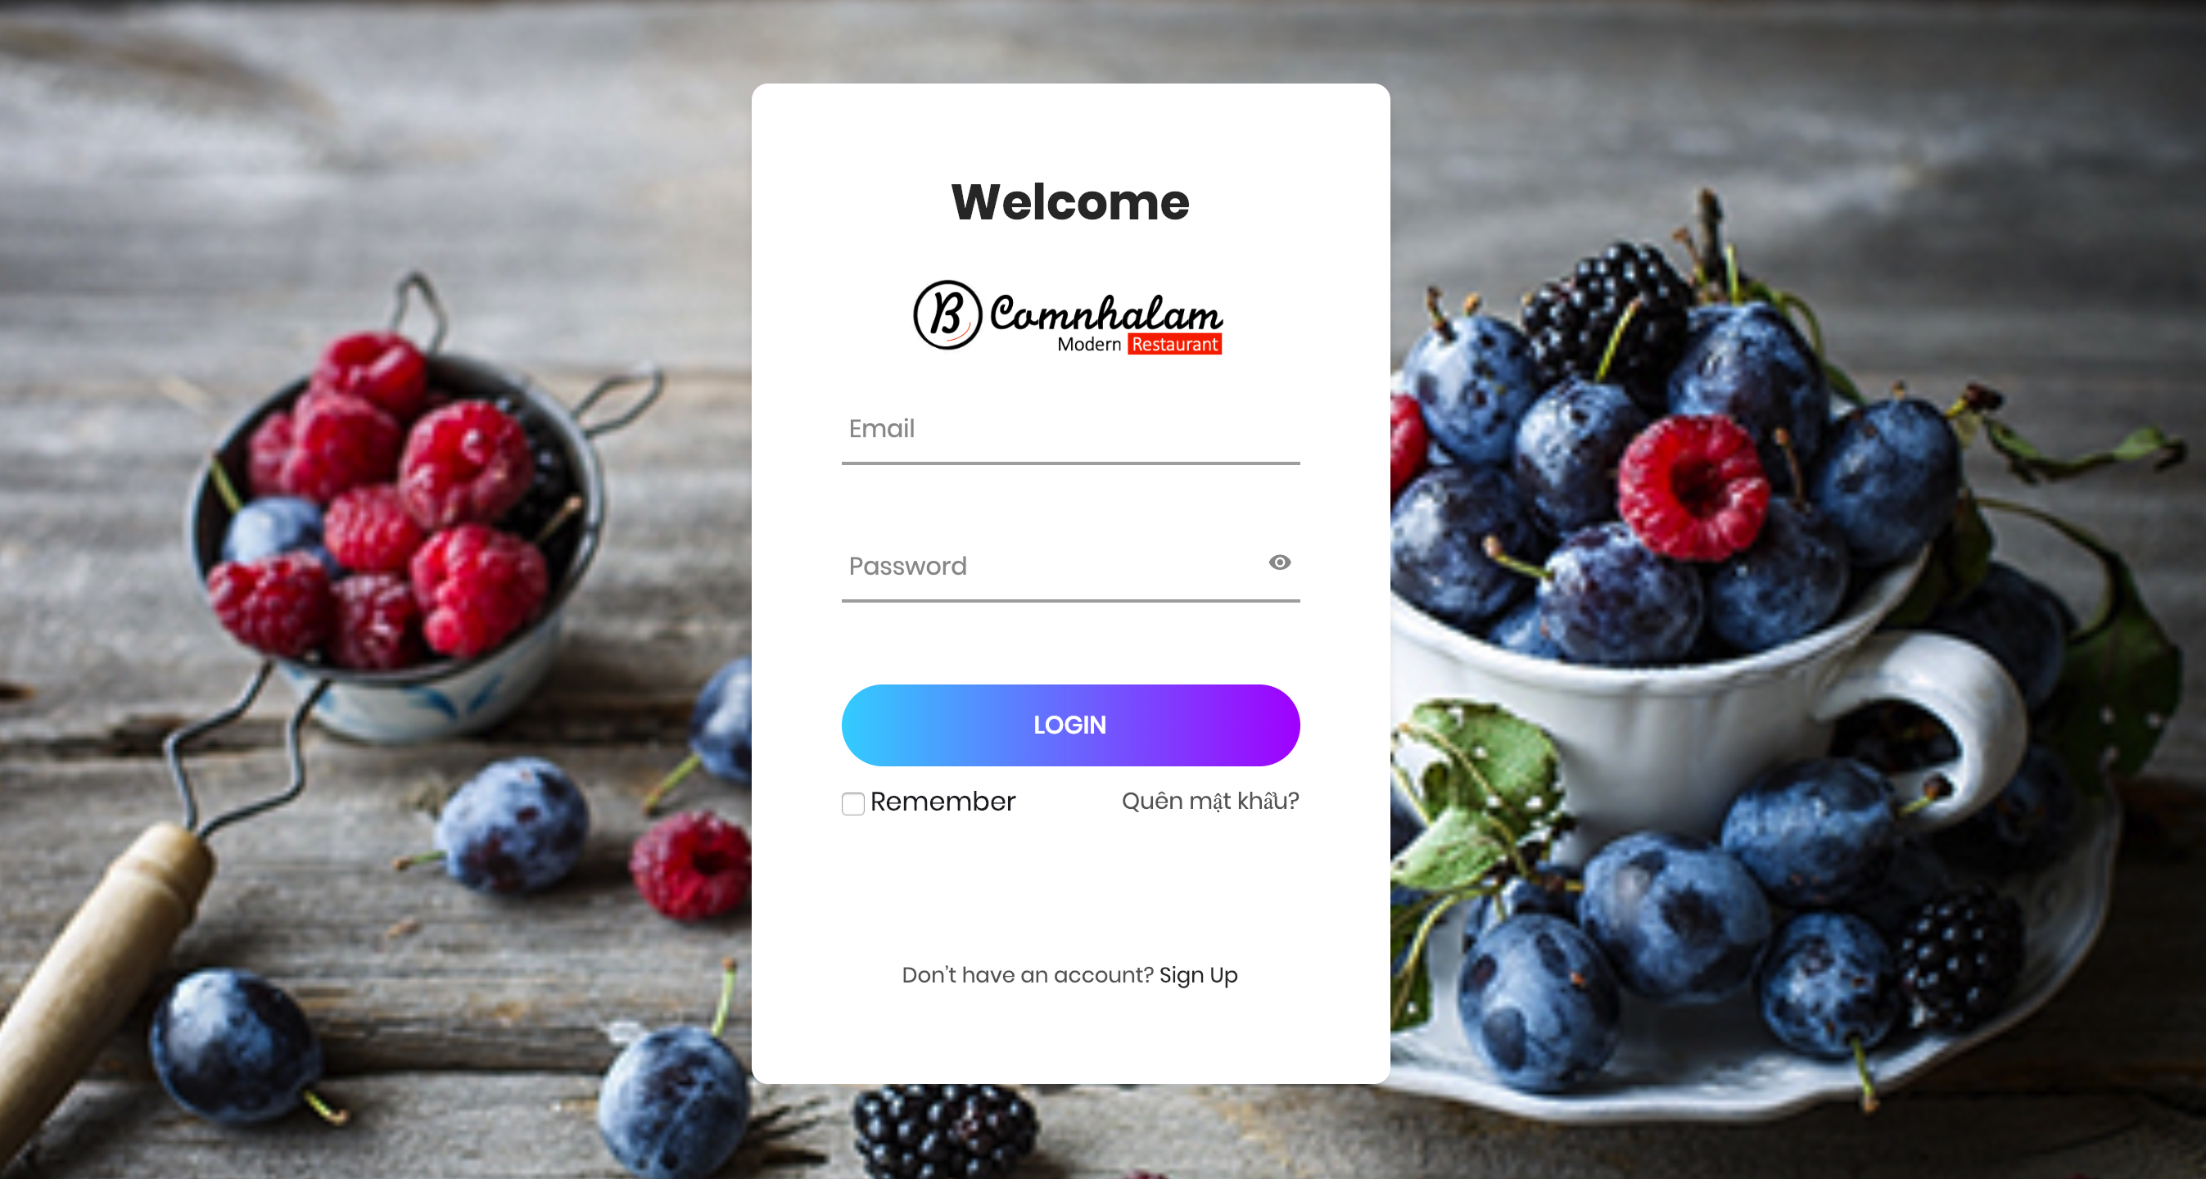
2

Slide 31
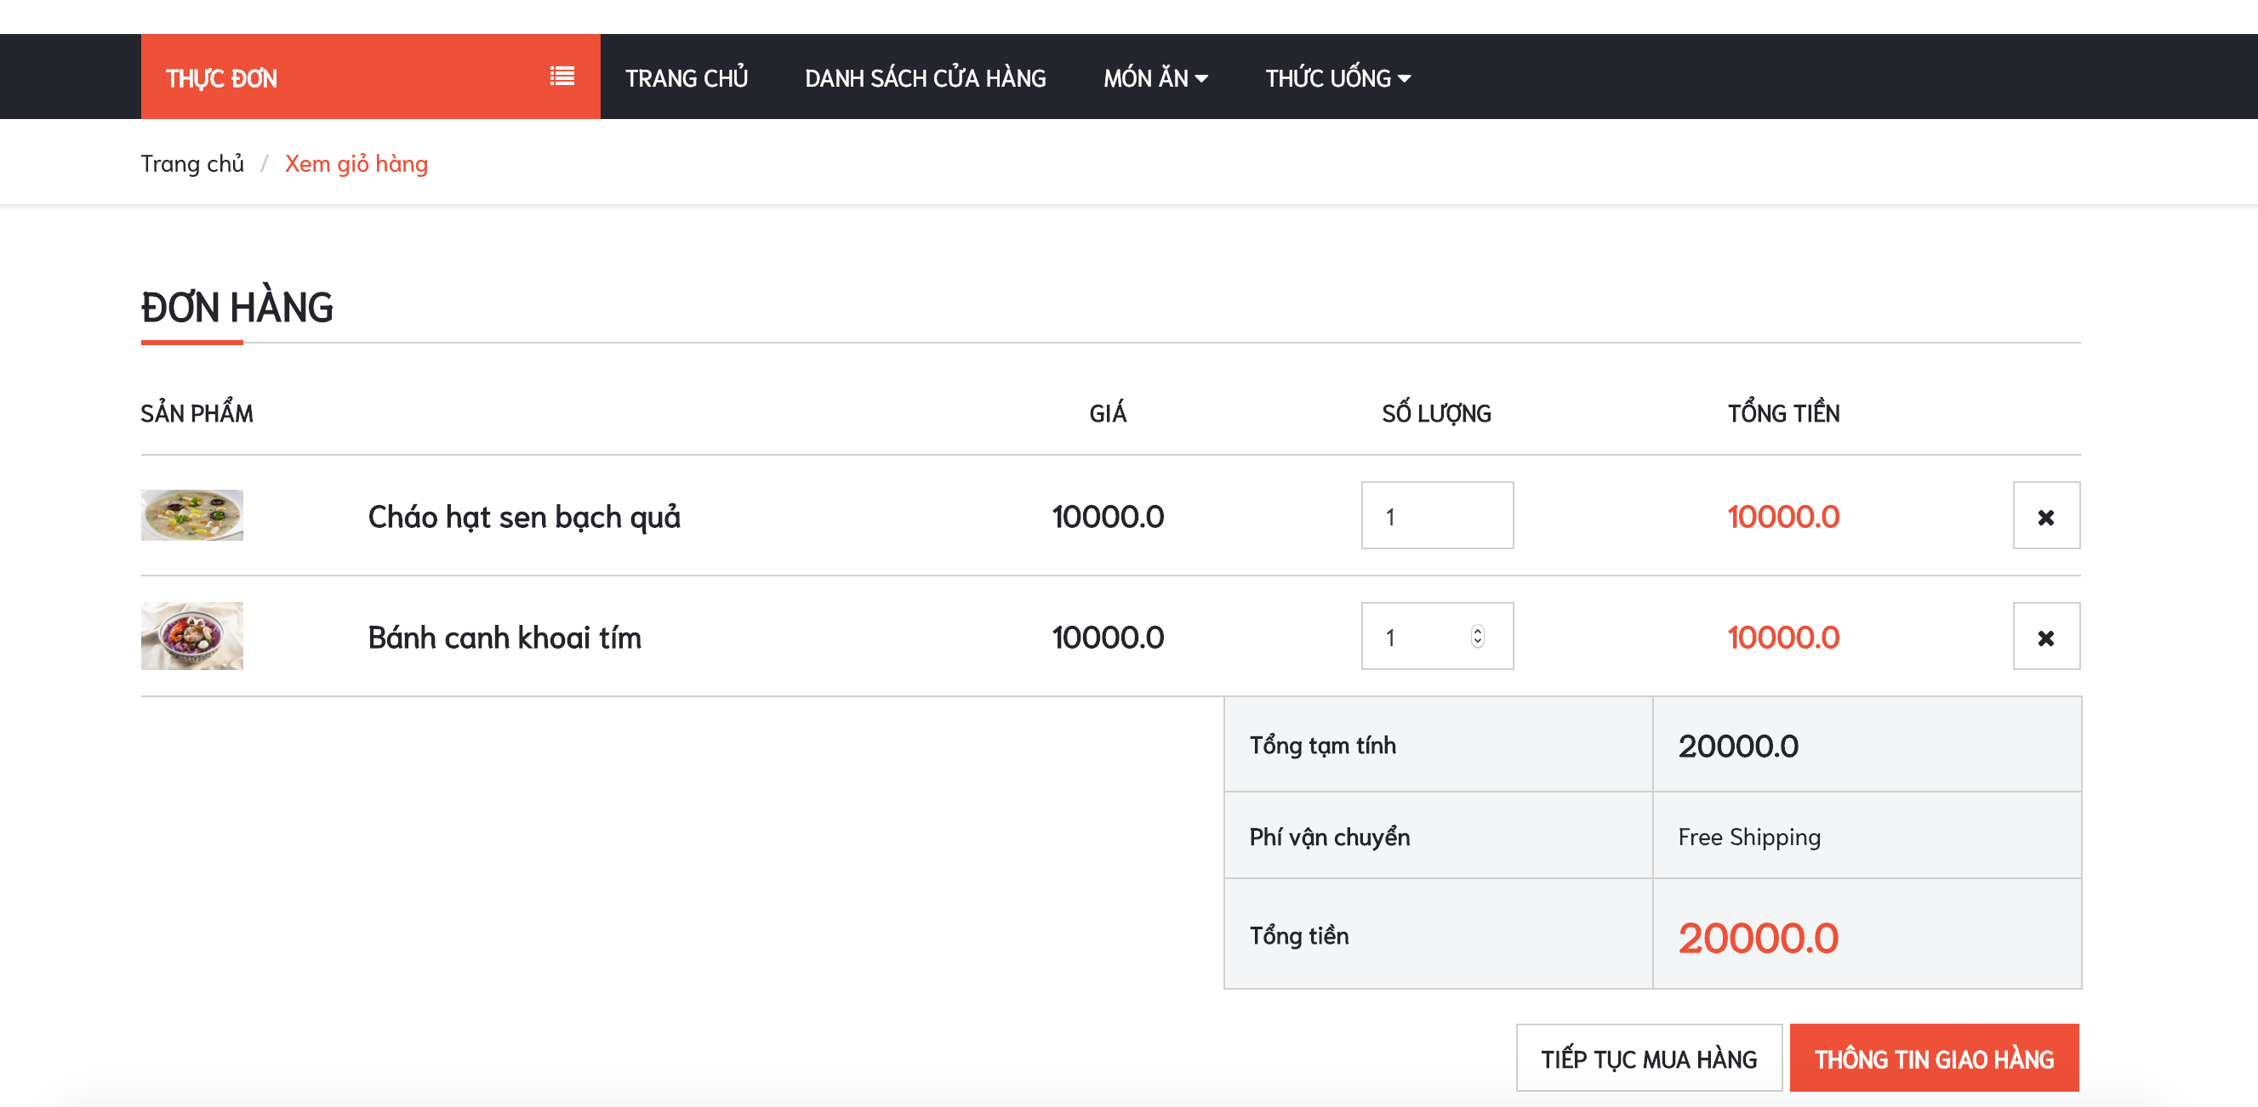
3

Slide 32
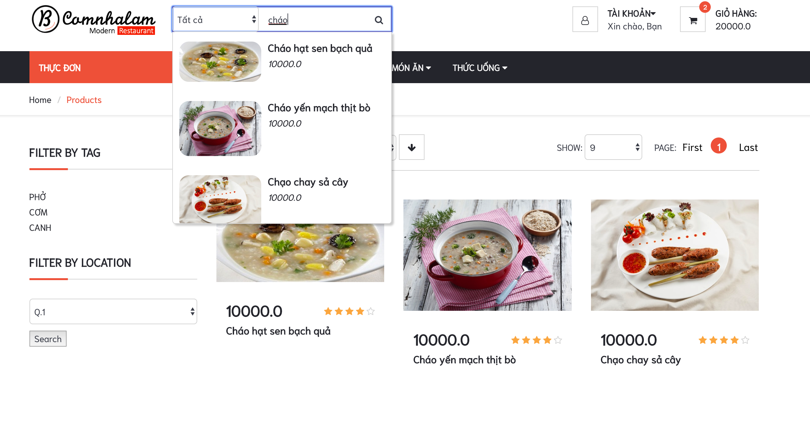
4

Slide 33
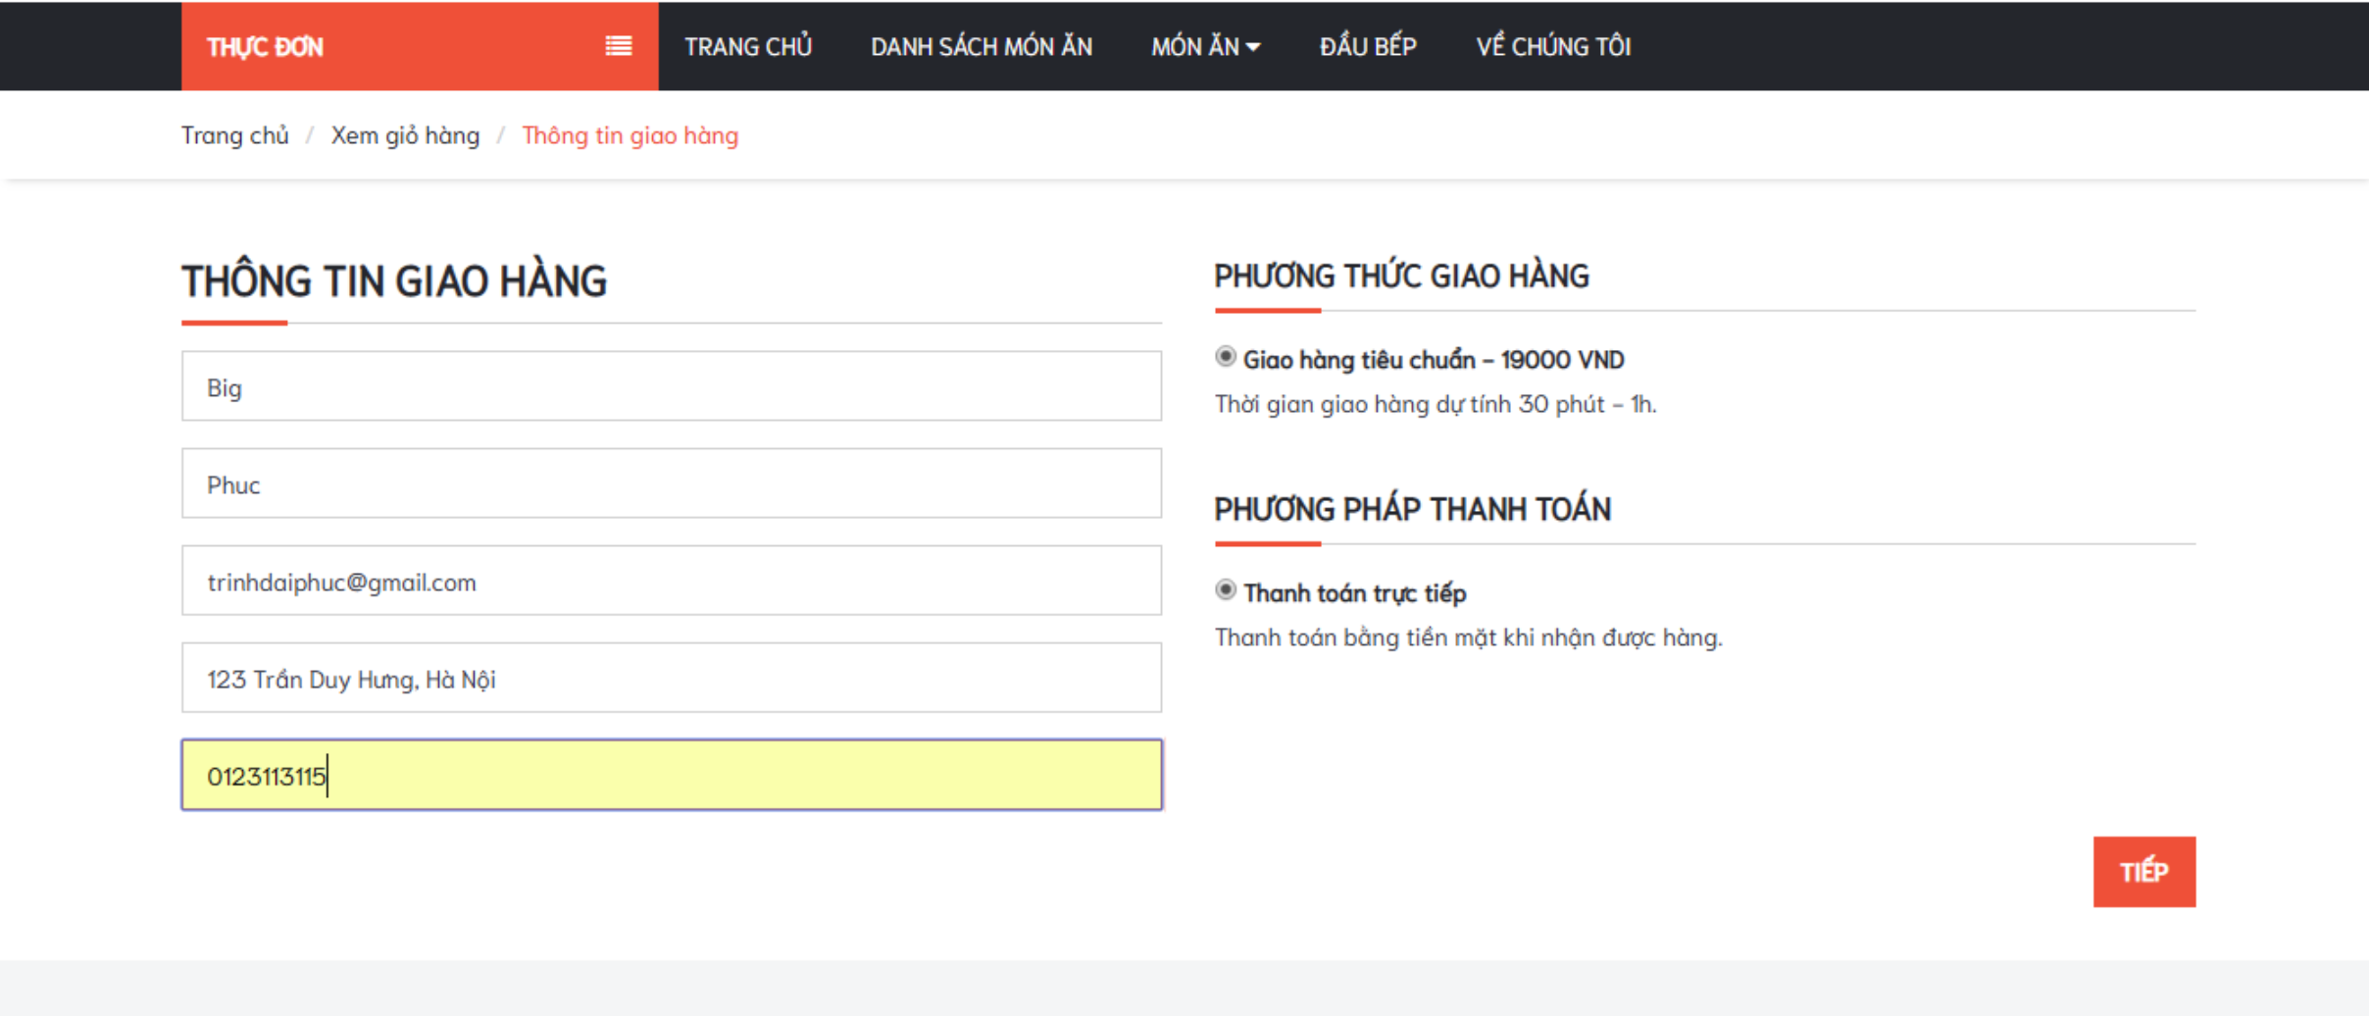
6

Slide 34
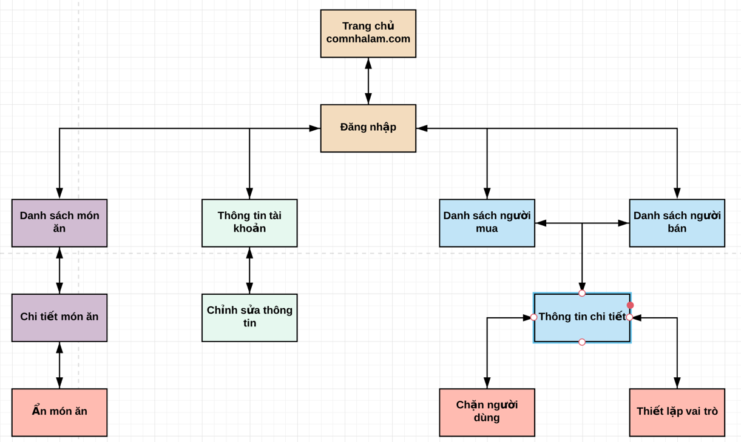
UI PROTOTYPE (2)
Administrator

Slide 35
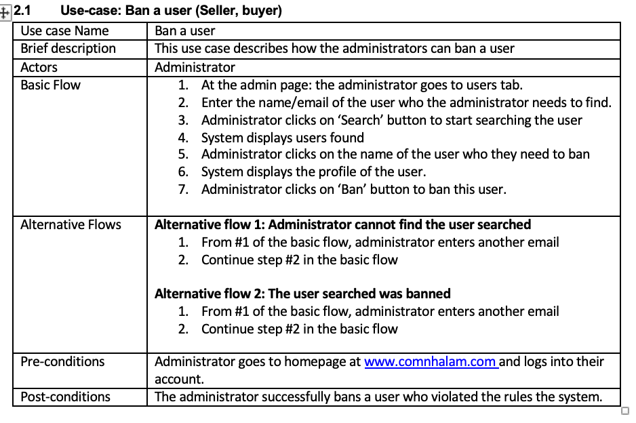
MAIN FEATURES (3)
(1) ADMINISTRATORS

Slide 36
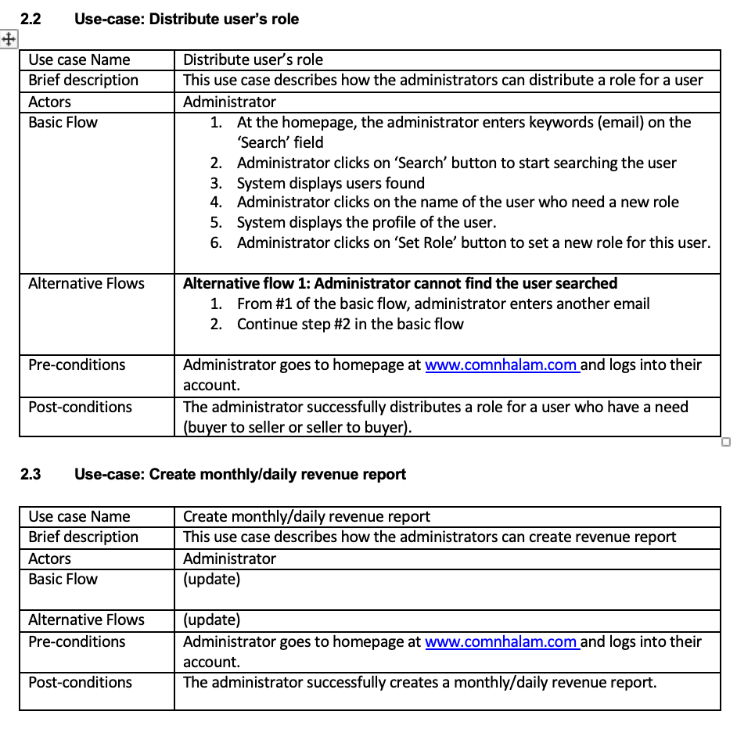

Slide 37
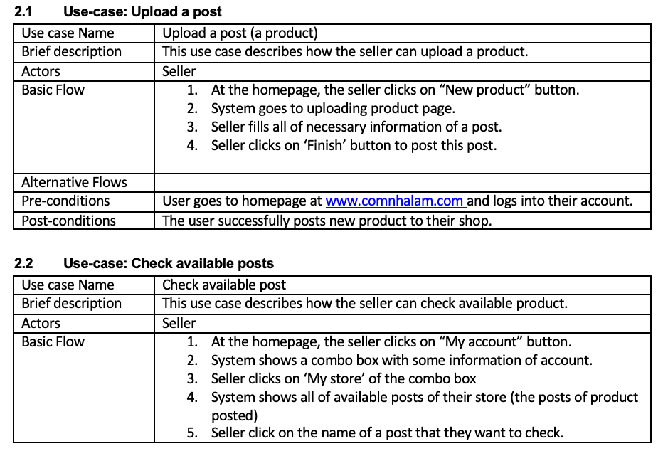
(1) SELLERS

Slide 38
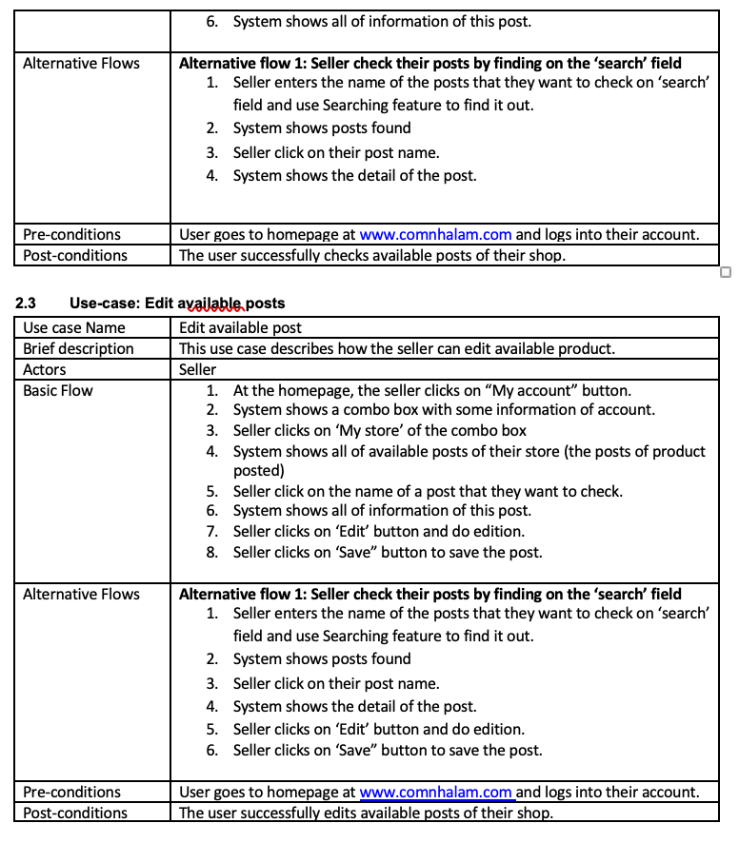

Slide 39
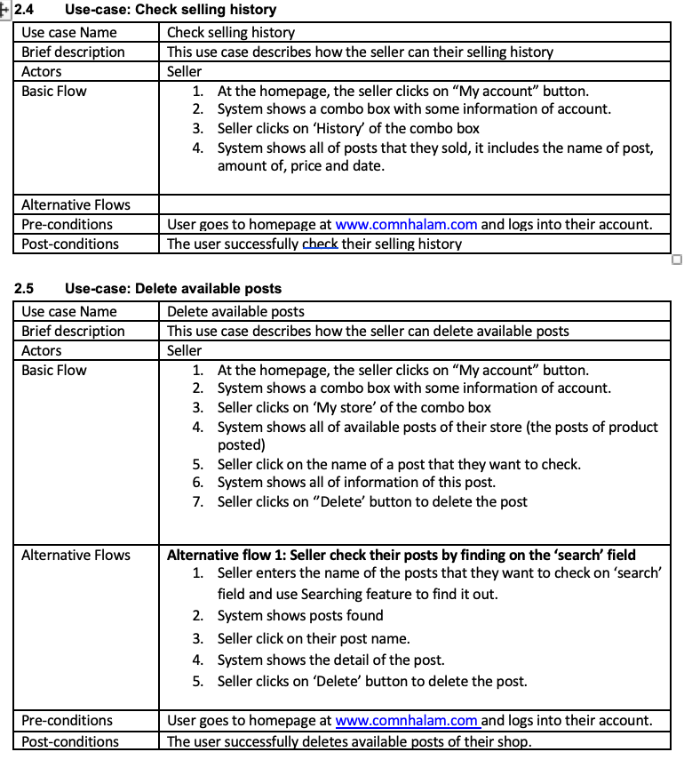

Slide 40
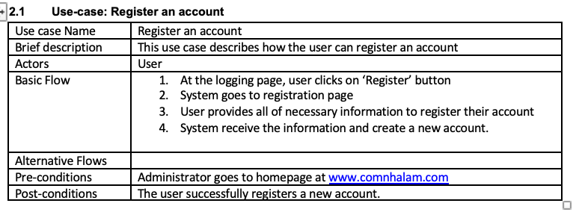
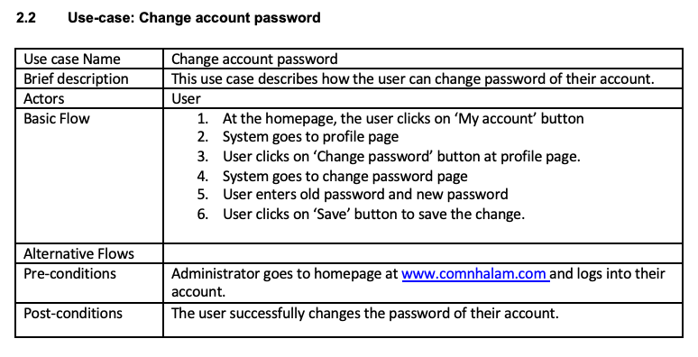
(3) BUYERS

Slide 41
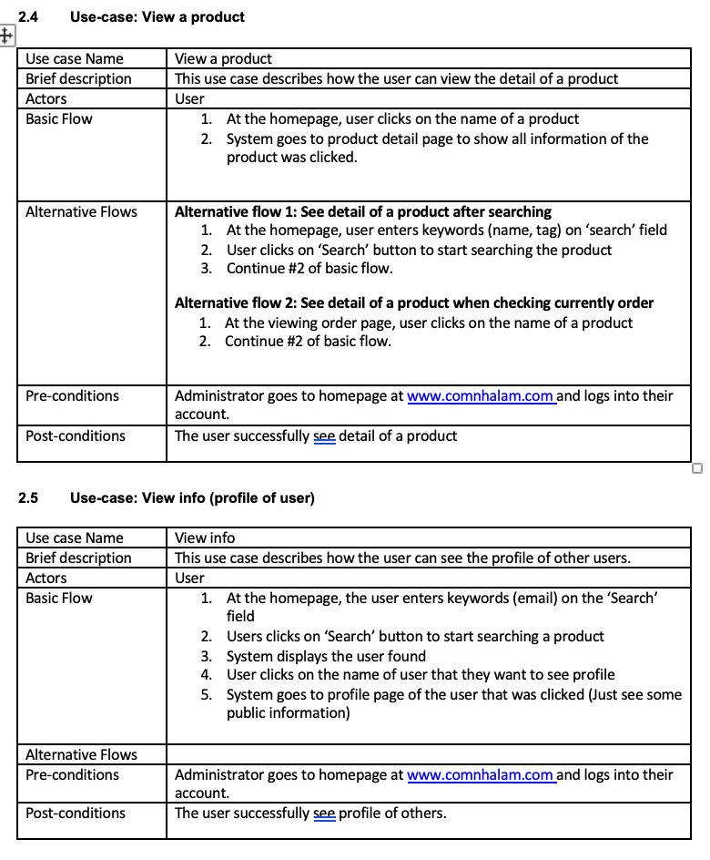
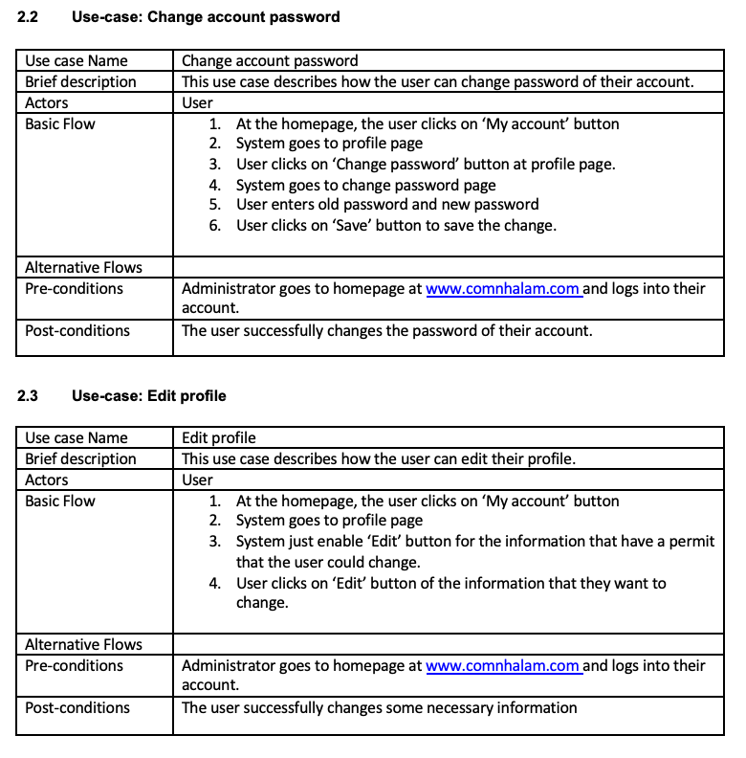

Slide 42
CONTENT
Content:
Overview
Scope
Organizational structure & responsibilities
Risk Management
Content:
Architecture goals & constraint
Logical view
Objective
Content:
Class diagram
UI Prototype
Content:
Test functions
Test environment
Roles
Test cases
Summary & Conclude
Content:
Order products
Checking order details
Schedule
Problem statement & product position statement
User-case model
SOFTWARE
REQUIREMENT
2. PROJECT MANAGEMENT
3. ANALYSIS AND DESIGN
4. SOFTWARE
TESTING
5. SOFTWARE DEMO

Slide 43
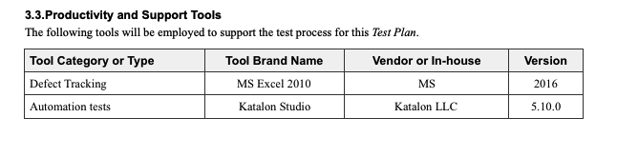
TEST ENVIROMENTS

Slide 44
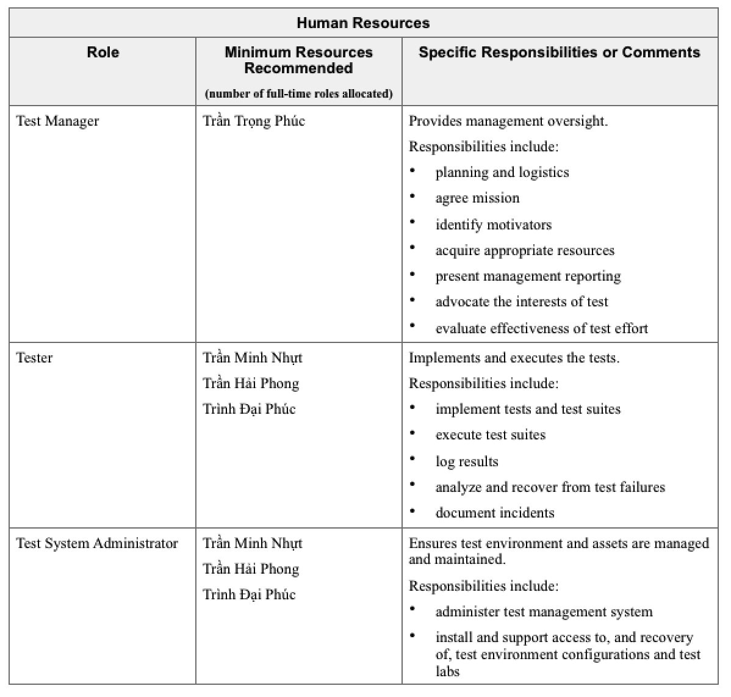
TEST PLAN

Slide 45
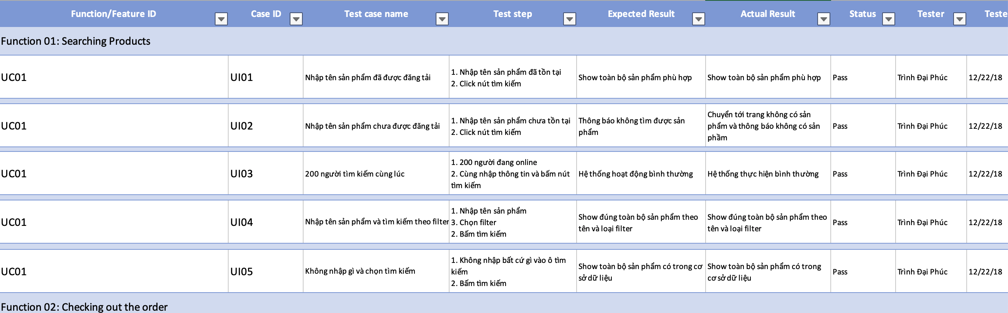
TEST – CASES (1)

Slide 46
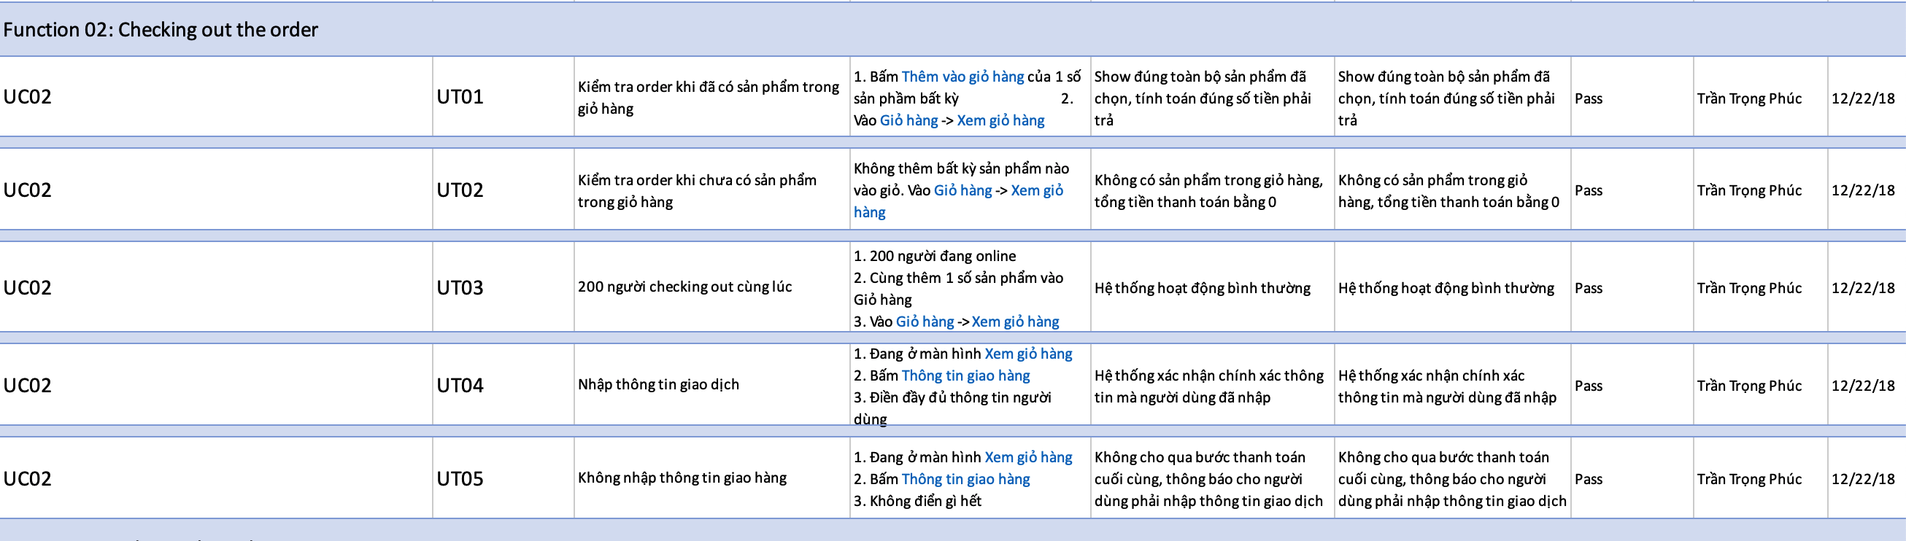
TEST – CASES (2)

Slide 47
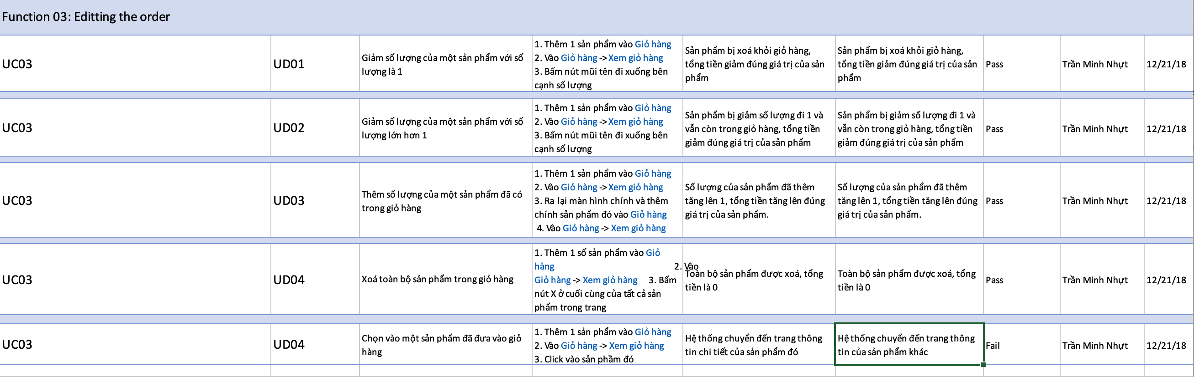
TEST – CASES (3)

Slide 48
CONTENT
Content:
Overview
Scope
Organizational structure & responsibilities
Risk Management
Content:
Architecture goals & constraint
Logical view
Objective
Content:
Class diagram
UI Prototype
Content:
Test functions
Test environment
Roles
Test cases
Summary & Conclude
Content:
Order products
Checking order details
Schedule
Problem statement & product position statement
Use-case model
SOFTWARE
REQUIREMENT
2. PROJECT MANAGEMENT
3. ANALYSIS AND DESIGN
4. SOFTWARE
TESTING
5. SOFTWARE DEMO

Slide 49


Slide 50
THANK YOU FOR
YOUR ATTENTION
Team 04 – 16CLC1

